Slide 1
Sarcasm detection
Information Retrieval II
Course Project

Slide 2
Introduction
Sarcasm is generally characterized as ironic or satirical wit that is intended to insult, mock, or amuse.
Recognizing sarcasm is important for natural language processing to avoid misinterpreting sarcastic statements as literal.
For example, sentiment analysis can be easily misled by the presence of words that have a strong polarity but are used sarcastically, which means that the opposite polarity was intended.

Slide 3
Sarcasm detection
Sarcasm detection refers to computational approaches to predict if provided text is sarcastic.
Consider following examples of sarcastic tweets:
“I can't wait to go home and start a craps ton of hw”
2. “If you can't laugh at yourself I'll do it for you ;-*”
3. “Wow I really love waking up with a headache!”
4. “I love it when people have the time to tweet something but not text me back”

Slide 4
Literature review
In literature, various approaches have been proposed for sarcasm detection
Reyes et. al [1] presented sarcasm detection model based on textual features. The model was evaluated on Twitter corpus
Riloff et. al [2] built sarcasm detector to predict if a provided tweet is sarcastic. A bootstrapping algorithm was developed that learns positive sentiment phrases and negative situation phrases from sarcastic tweets.
Buschmeier et. al [3] formulated the problem of sarcasm detection as a supervised classification task. They evaluated various classifiers trained using linguistic features of text.
Bamman et. al [4] studied the impact of context (defined by properties of author and audience) in identification of sarcasm along with linguistic features

Slide 5
Literature review
 | Features | Dataset
Reyes et. Al [1] 2012 | Features include ambiguity, polarity, unexpectedness, and emotional content | Twitter corpus of 50K tweets
Riloff et. Al [2] 2013 | Sarcastic patterns (positive and negative phrases) | Twitter corpus of 3K tweets
Buschmeier et. al [3] 2014 | Punctuation, Hyperbole, Interjection, Emoticon | Amazon Product Reviews (1,254 reviews)
Bamman et. al [4] 2015 | historical salient terms, historical topic, profile info, historical sentiment and linguistic features | Twitter corpus of 19K

Slide 6


Architecture
Labelled Corpus
Preprocessing
Feature Extraction
Partitioning Data
Train set
Test set
Sarcasm Detection App
Evaluate
Train Sarcasm Detection Classifier

Slide 7
Data acquisition
The dataset of 3000 tweets were requested from Riloff et. al [2].
Due to the privacy policy of Twitter, only tweet_ID was shared by the Riloff et. al [2]
Using Tweepy package of Python, tweets were rebuild but the corpus size reduced to 1948 tweets as the remaining tweets were either removed by authors or the accounts were deactivated.

Slide 8
Preprocessing
Preprocessing includes following steps:
Remove punctuations and whitespaces
Remove non-alphanumeric characters.
Remove URLs
Convert to lower case
Remove stop words(is, a, it, etc.)
Extraction of hashtags from tweets

Slide 9
Feature extraction
Exclamation Marks
Ellipses
Interjections
Intensifiers
Count of Hashtags
Capitalization
Question Marks
Emoticons
Contradiction
Hashtags
TF-IDF
Word Embeddings

Slide 10
Feature extraction
S. No | Feature | Explanation | Example
1. | Exclamation Marks | The binary feature represents presence of exclamation mark | Bring it on exams!!! #onmondaypa:)
2. | Ellipses | An ellipsis is a series of dots (typically three, such as "…") that usually indicates an intentional omission of a word. The binary feature represents presence of ellipse in the tweet. | Yeeeee!!! College class in the A.M is where its at boiii!!!! WOOOOO!! #Sarcasm ......
3. | Interjections | An interjection is a part of speech that shows the emotion or feeling of the author. For example, Wow, whoa. The feature represents the count of interjections present in the tweet | Wow my fridge is so full!:( #sarcasm

Slide 11
Feature extraction
S. No | Feature | Explanation | Example
4. | Intensifiers | Intensifiers are the words used with adjectives or adverbs to make them stronger. The feature represents the count of intensifiers present in the tweet | I'm really excited for night class #sarcasm
5. | Count of Hashtags | Count of hashtags used in the tweet | So excited for school ! #jk #sarcasm #h8school
6. | Capitalization | Count of words in text with all capital letters | “Oh my word!!! That didn't just happen!!! GREAT someone is having right good laugh surely #cheers #sarcasm”

Slide 12
Feature extraction
S. No | Feature | Explanation | Example
7. | Question Marks | The binary feature represents presence of Question mark in the tweet | Ron Paul gave the #GOP the cold shoulder?? You don't say.... I'm shocked. #Sarcasm
8. | Emoticons | The feature represents count of emoticons present in the tweet | Oh how i love being a klutz #sarcasm :-/ ☹
9. | Contradiction | Contradiction refers to the presence of positive and negative words in the tweet | Absolutely love being left to hang #SARCASM
10. | Hashtags | The feature represents presence of any of the hashtags including [#not, #sarcasm] | Six hours of sleep is perfect................ #not #sarcasm

Slide 13
TF-IDF
LESS 'important' words occur MORE often
Words can be weighted by "their inverse document frequency (IDF)"
Document Term Matrix was computed using scikit-learn library in python
TF-IDF metric was used to compute the score of each word present in the tweet

Slide 14
Word embedding
A vector based approach to extract features from raw text. Word2vec vectorizes about words, and by doing so it makes natural language computer-readable - we can start to perform powerful mathematical operations on words to detect their similarities
Word2vec, published by Google in 2013, is a neural network implementation that learns distributed representations for words.
Word2vec is an unsupervised learning approach that clusters similar words together.
In this project,word2vec implementation of genism package is used. A pretrained word2vec model trained on Google News was used.

Slide 15
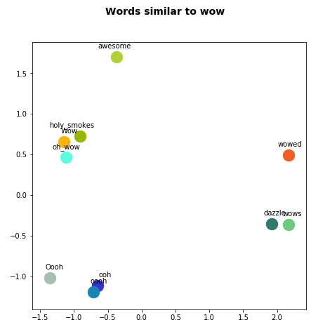
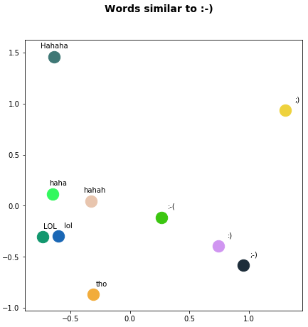
Word Similarities

Slide 16
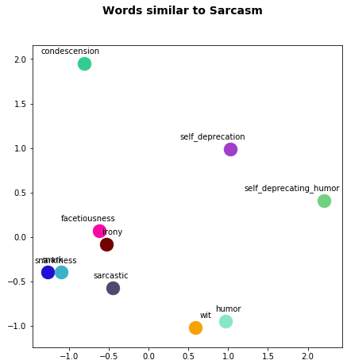
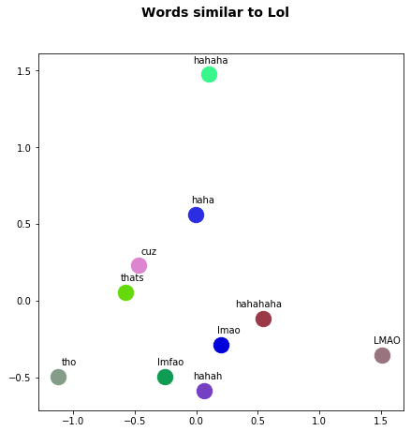
Word Similarities

Slide 17
Data Partition
For model training and evaluation, dataset was splited into train set and test set
Dataset | Size
Train set | 1539 tweets
Test set | 409 tweets

Slide 18
Model Training
Model was trained using different classification algorithms including Random Forest classifier, XGBoost classifier and Logistic Regression
Algorithm parameters were tuned using 3 fold cross validation
Accuracy and F-measure were used as the model evaluation metrics
Accuracy: is defined as the ratio of correct predictions made by the classifier to the total number of test samples
F-measure: F-measure incorporates both Recall and Precision and is calculated as,
Accuracy = (TP + TN)/ (TP+FP+TN+FN)
Where,
TP = True Positive
TN= True Negative
FP = False Positive
FN = False Negative
F-measure= 2 * (Precision * Recall) / (Precision + Recall)

Slide 19
Evaluation Result
Feature Set | Algorithm | Accuracy | F-Measure
TF-IDF + Linguistic Features | Random Forest | 0.819 | 0.82
 | XGBoost | 0.84 | 0.84
Word2Vec Feature + Linguistic Features | Random Forest | 0.76 | 0.77
 | XGBoost | 0.825 | 0.80

Slide 20
Importance of Linguistic Features

Slide 21
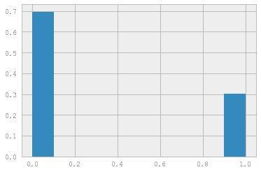
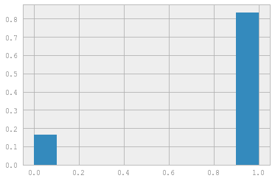
Hashtags (#Not, #SARACASM)
Non Sarcastic Tweets
Sarcastic Tweets

Slide 22
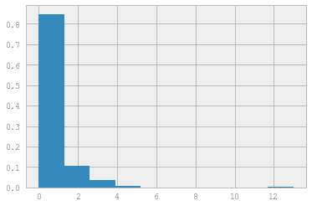
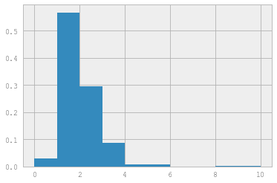
Count of Hashtags
Non Sarcastic Tweets
Sarcastic Tweets

Slide 23
references
Reyes, Antonio, Paolo Rosso, and Davide Buscaldi. "From humor recognition to irony detection: The figurative language of social media." Data & Knowledge Engineering 74 (2012): 1-12.
Riloff, Ellen, Ashequl Qadir, Prafulla Surve, Lalindra De Silva, Nathan Gilbert, and Ruihong Huang. "Sarcasm as Contrast between a Positive Sentiment and Negative Situation." In EMNLP, vol. 13, pp. 704-714. 2013.
Buschmeier, Konstantin, Philipp Cimiano, and Roman Klinger. "An Impact Analysis of Features in a Classification Approach to Irony Detection in Product Reviews." In WASSA@ ACL, pp. 42-49. 2014.
Bamman, David, and Noah A. Smith. "Contextualized Sarcasm Detection on Twitter." In ICWSM, pp. 574-577. 2015.
Joshi, Aditya, Vaibhav Tripathi, Kevin Patel, Pushpak Bhattacharyya, and Mark Carman. "Are Word Embedding-based Features Useful for Sarcasm Detection?." arXiv preprint arXiv:1610.00883 (2016).

Slide 25
Thank you

